Slide 1
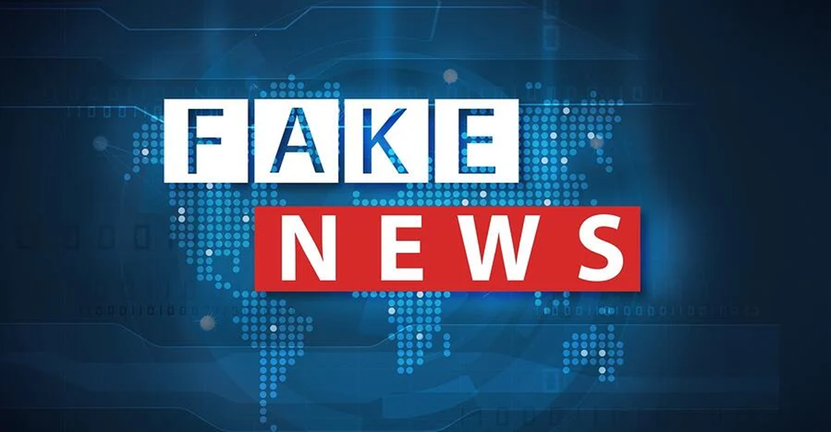
Navigating online news
Can you tell what is real or fake news?
Sponsored content
Fake news for cash: clickbait
Fake news for political reasons
Creating our own fake news: confirmation bias and ‘echo chambers’

Slide 2
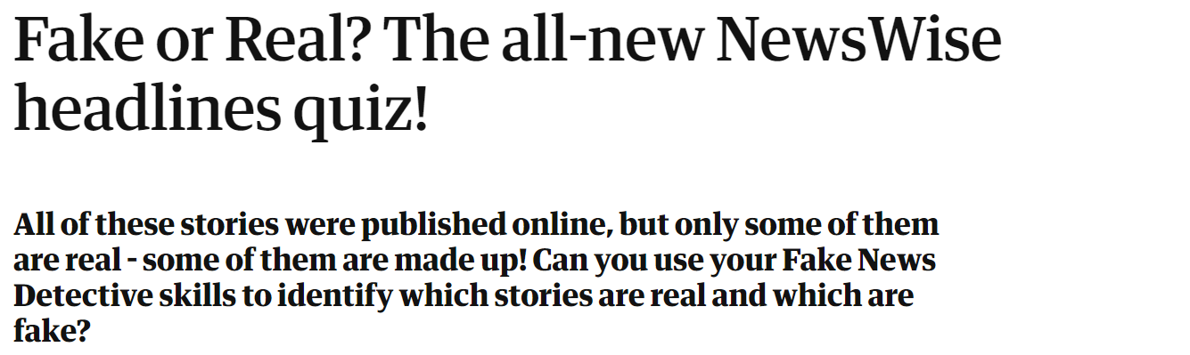
Can you tell what is real or fake news?
https://www.theguardian.com/newswise/2021/feb/04/fake-or-real-headlines-quiz-newswise-2021
Click this link to take the quiz

Slide 3
As the quiz that you have just done shows, it is very difficult to be able to tell exactly what is true and what
It is often not clear exactly who has written an article on the internet, and even if we do know that it is even more likely that we will not be able to see what their sources of information are.
Watch this clip (start at 6.12 and go to 10.20) from John Green’s ‘Crash Course: Navigating Digital Information’
What does it say is the most important thing to bear in mind when reading news online?
What other things could we do to check information online beyond what John Green is saying?
Trying to uncover the Truth

Slide 4

Sponsored content
Sometimes when we are reading what looks like ‘news’ in fact we are reading what is called ‘sponsored content’. That is material which looks like is just reporting facts but is, in fact, an advertisement.
This form of content is growing rapidly in popularity because it is so successful, with far more readers willing to look at an article that looks like ‘real’ news rather than something that is obviously an advert

Slide 5

Good examples of sponsored content
This first ‘news story’ is about a new running track created by Nike. It is not specifically telling you to buy anything. Why do you think it is actually brilliant advertising for Nike products?
This website is slightly more subtle. It is explaining about healthy eating which seems a very good thing to read about. What is the motive behind this article though produced by the company ‘Healthline’?

Slide 6
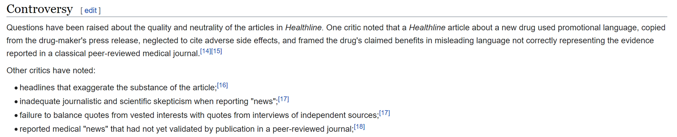
Very often it is a good idea to check ANOTHER source to see if what you have read is really accurate.
For example, if you click on the Wikipedia entry for Healthline:

Slide 7
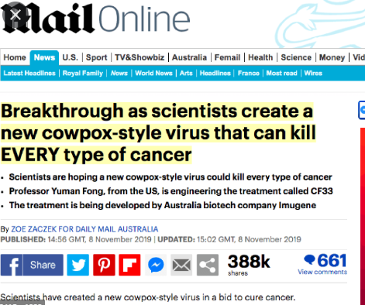
Fake news for cash: clickbait
As well as looking to advertise particular products sometimes people are JUST wanting you to click on their website. This is because the more people who click on a website the more they will be paid by companies advertising on that site.
Articles written to attract visitors to a website are known as ‘clickbait’. They are not written to be accurate, but to make us more likely to visit the site.
This video explains how clickbait works

Slide 8
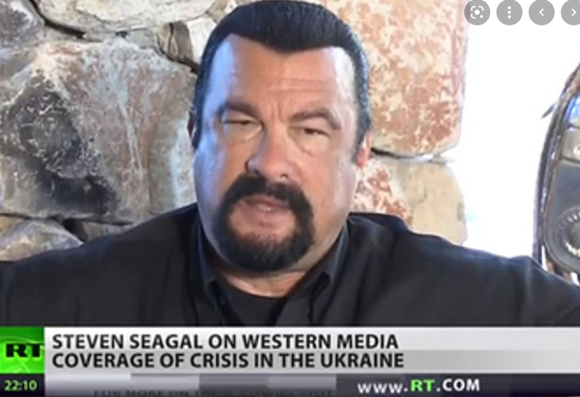
Fake news for political reasons
Sometimes news reports are manipulated by a political party or government in order to achieve a particular political objective.
See for instance this reporting last year on protests against the President of Belarus. These peaceful protests were opposed to the President, Alexander Lukashenko, who ignored the popular vote, claimed the votes were rigged, and is still in power.
Another example of this can be seen here with this manipulated news footage of Joe Biden.

Slide 9
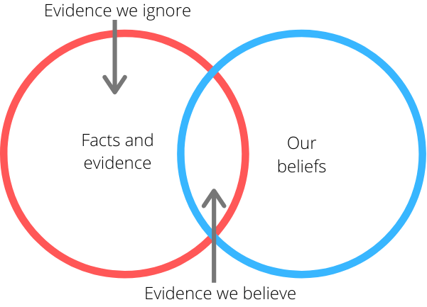
Creating our own fake news: confirmation bias and ‘echo chambers’
With algorithms running many online sites from google to spotify to amazon we are also manipulating our own view of the world around us without even meaning to. Every time we click on a news article and choose to listen a particular song algorithms will pick up on that and tend to give us more of the same next time we search for something.
This is helpful in many ways, but it means that increasingly everyone’s online world is tailored to them and means that it is harder to have a clear perspective and Empathy (the word used by John Green earlier) for other people’s views.
This all plays into our own human inclination to confirmation bias which is explained here

Slide 10
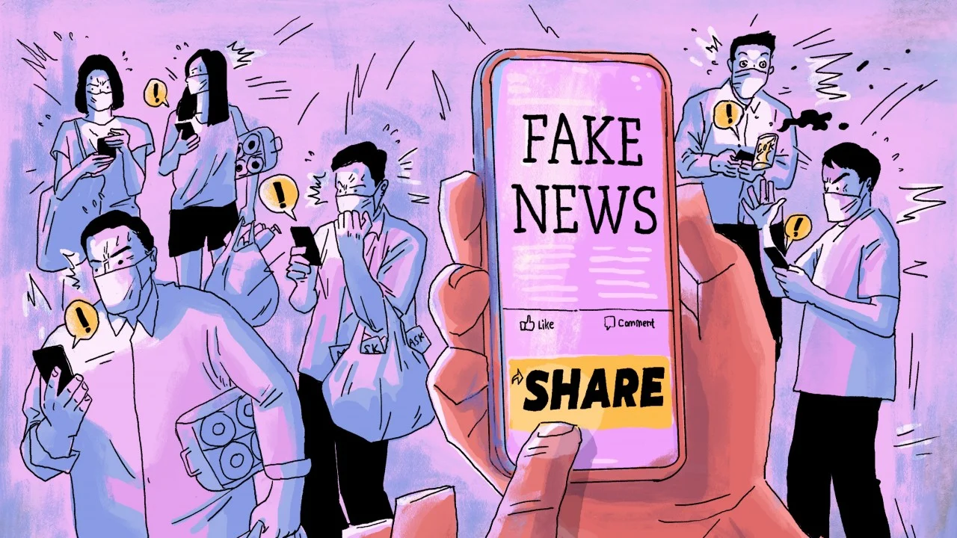
Conclusions
There is a lot of extremely useful information out there on the internet, but we always have to be careful about how we read what is out there.
What key lessons do you think you will draw from this lesson for the next time you are scrolling through news sites online or researching for your homework?

